Slide 1

FORMULA 1
Data Analytics Project

Slide 2
What is Formula 1 a.k.a F1?
Notes:
Formula One is the highest class of international racing for open-wheel single-seater formula racing cars
The word formula in the name refers to the set of rules to which all participants' cars must confirm
A Formula One season consists of a series of races, known as Grands Prix, which take place worldwide on both purpose-built circuits and closed public roads
Now over to Jatin to explain WHY WE CHOOSE F1

Slide 3
Why Formula 1?

Slide 4
01
Circuits
Dataset
Overview
02
Constructor_results
03
Constructor_standings
04
Constructors
05
Driver_standings
06
Drivers
07
Lap_times
08
Pit_stops
09
Qualifying
10
Races
11
Results
12
Seasons
13
Sprint_results
14
Status

Slide 5
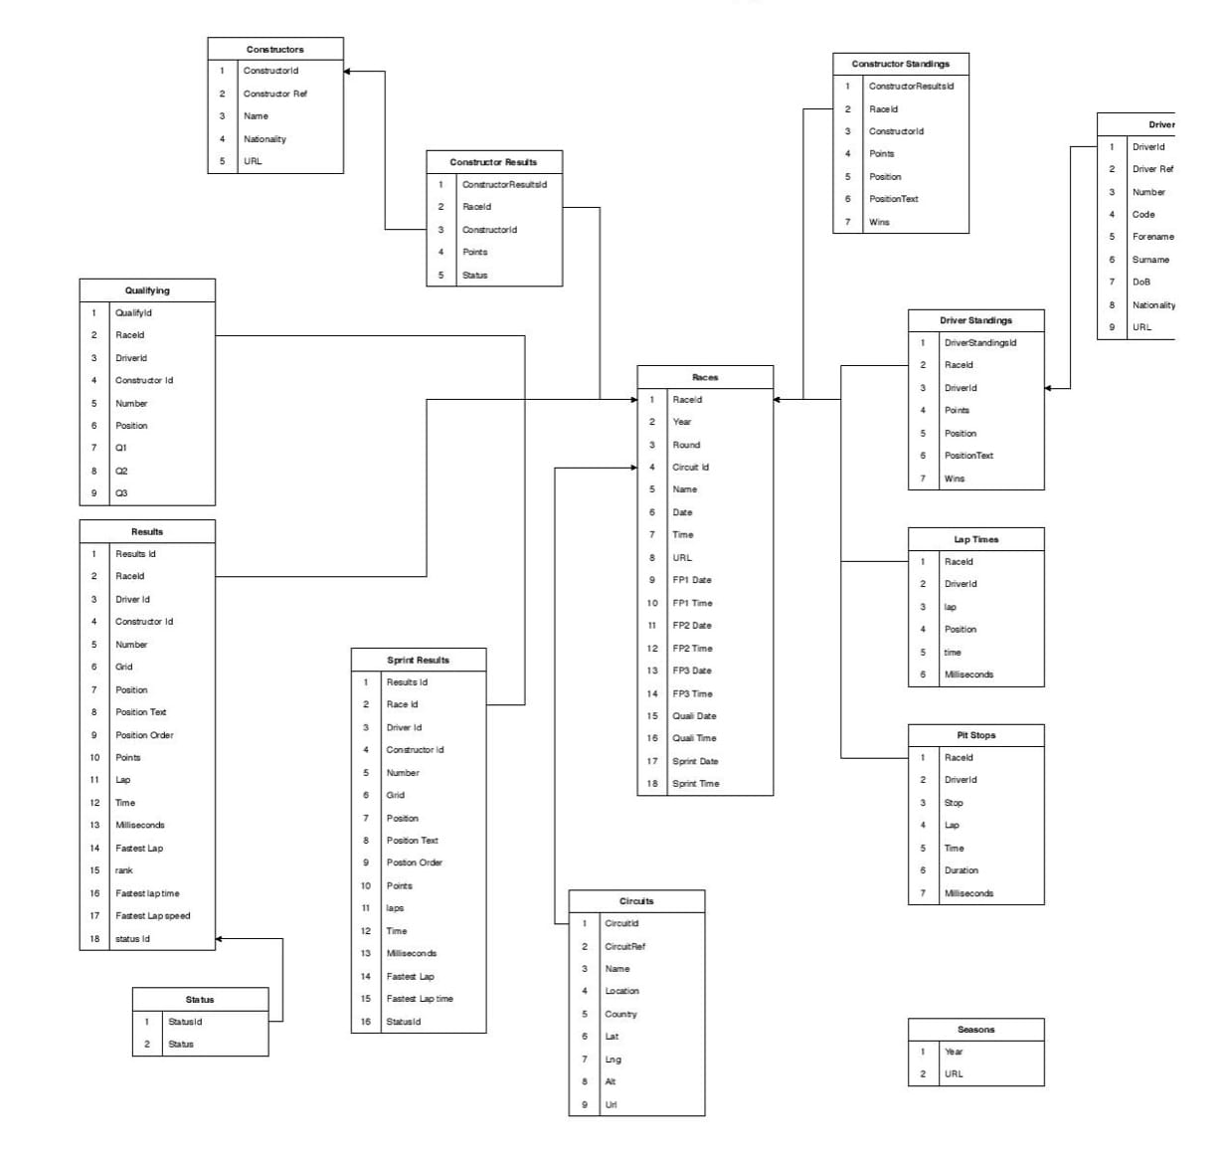
ER Diagram

Slide 6
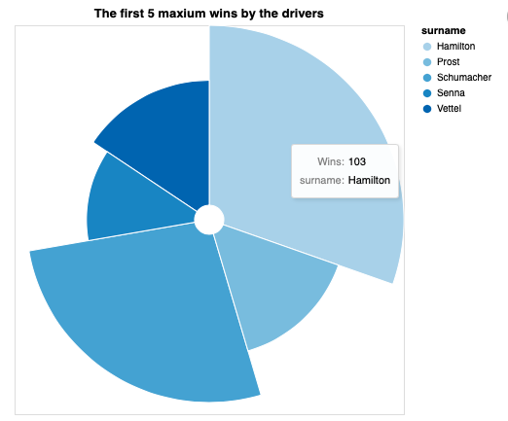
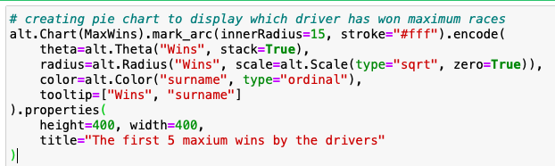
Maximum Race

Slide 7
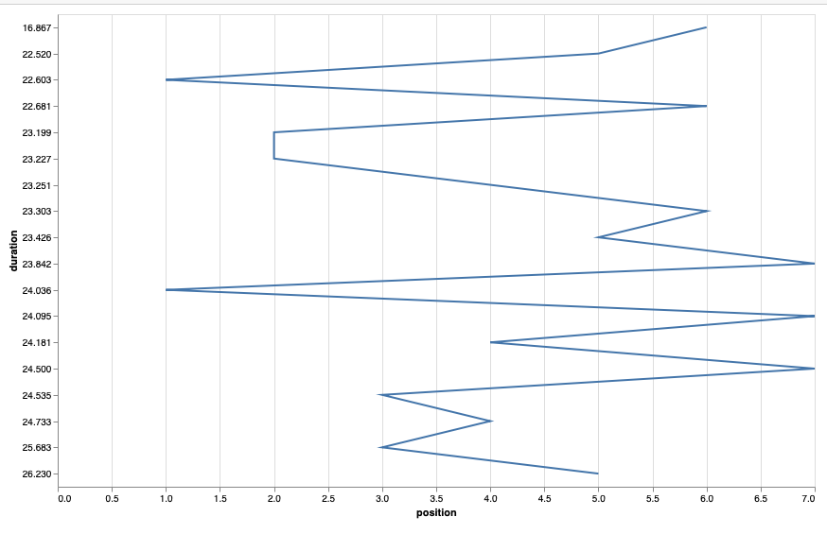
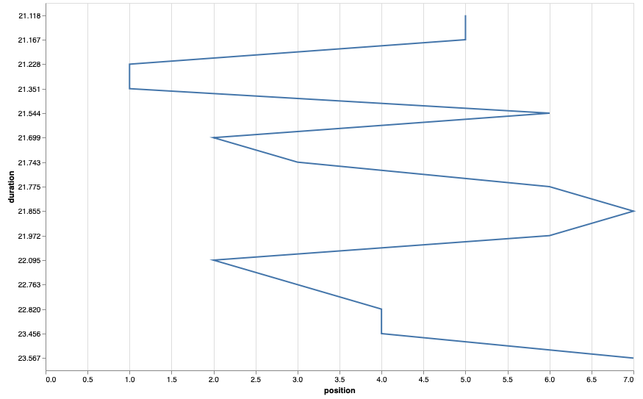
Pit stops contribution in a Race​
What is pit stop and why it is imp? They replace tires, refuel, repair damaged wings or make other modifications to the car to change the down-force and improve performance.
RaceId 841
RaceId 1086
Notes:
What is pit stop and why it is imp? They replace tires, refuel, repair damaged wings or make other modifications to the car to change the down-force and improve performance.
In order to do this analysis, I have choosen random races to find out whether pitstops affects in winning a race.
From ’raceId 841’ on ‘Position 1’ has taken 2 pit stops for (1st at 21.6 and 2nd at 24.03 ) total = 45.9 less than a minute
and ‘Position 7’ has taken 3 pit stops for (1st at 23.8 and 2nd at 24.09 and 3rd at 24.5 ) total = 72.39 which is 1min 12sec
In both the position 1 and 7 has difference of 43sec.
From ’raceId 1086’ on ‘Position 1’ has taken 2 pit stops for (1st at 21.2 and 2nd at 21.3 ) total = 42.5
and ‘Position 7’ has taken 2 pit stops for (1st at 21.8 and 2nd at 23.5 ) total = 45.3
In both the position 1 and 7 has difference of 4sec. Both of them have taken 2 pit stops.
From both the graph we conclude that Yes, fast pitstops do contribute in wining the race.

Slide 8
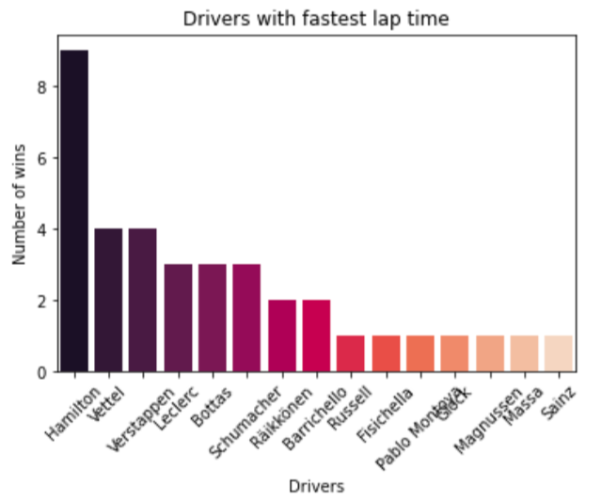
Fastest lap times across every circuit
Get a modern PowerPoint Presentation that is beautifully designed. Easy to change colors, photos and Text.
I hope and I believe that this Template will your Time, Money and Reputation. Easy to change colors, photos and Text.

Slide 9
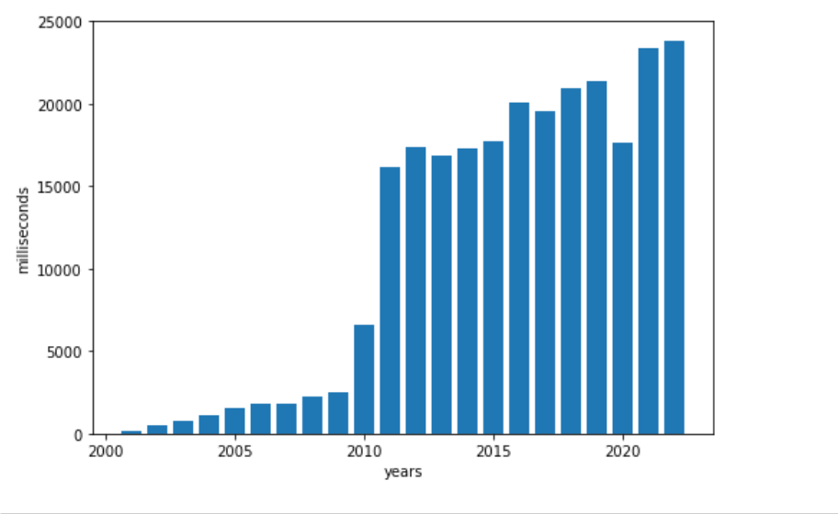
The current bar graph depicts the total milliseconds the races conducted each year

Slide 10
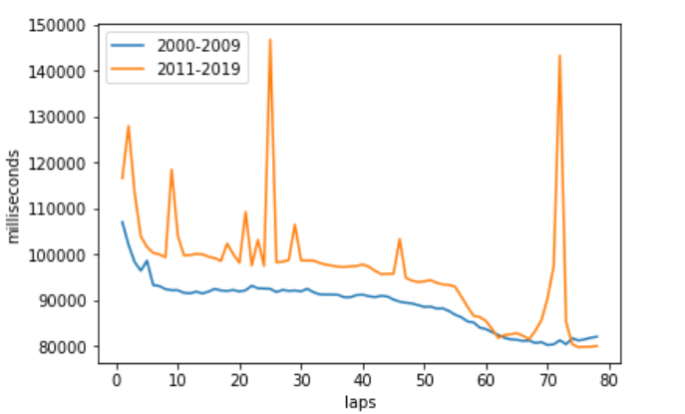
The double line graph depicts the total milliseconds taken by each lap as an average in 2 categories
The categories are 2000-2009 and 2011-2019. the lap times in 2011-2019 are more compared to the 2000-2009 lap times.
The highest lap time was in the 25th lap.

Slide 11
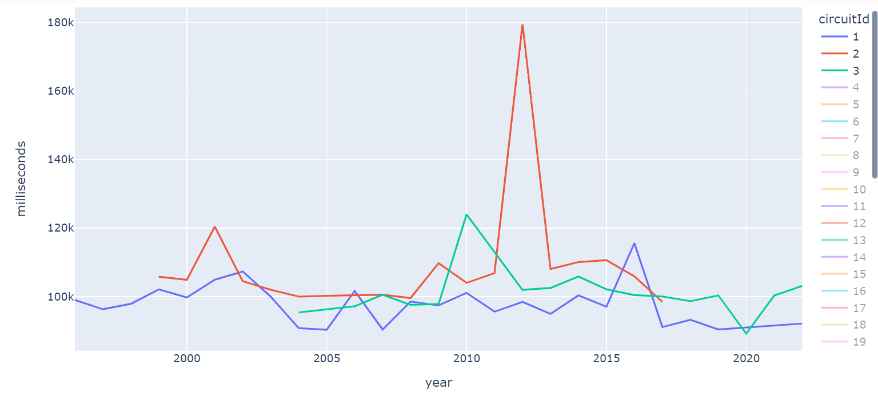
In the line graph we can find, the total number of milliseconds the race was conducted in that particular year for a specific circuit Id.

Slide 12
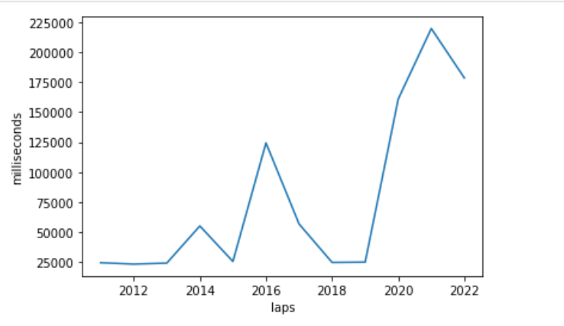
Line graph depicting the total number of milliseconds taken in a lap for pit stops.

Slide 13
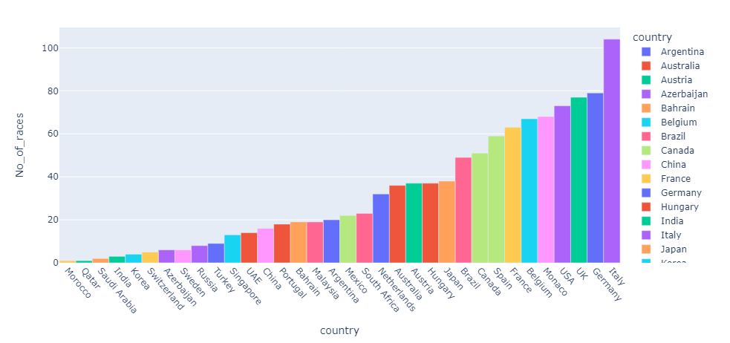
Distribution of races hosted by countries across all seasons
Italy has been the top country to host the Formula 1 races across the world, followed by Germany, UK and USA

Slide 14
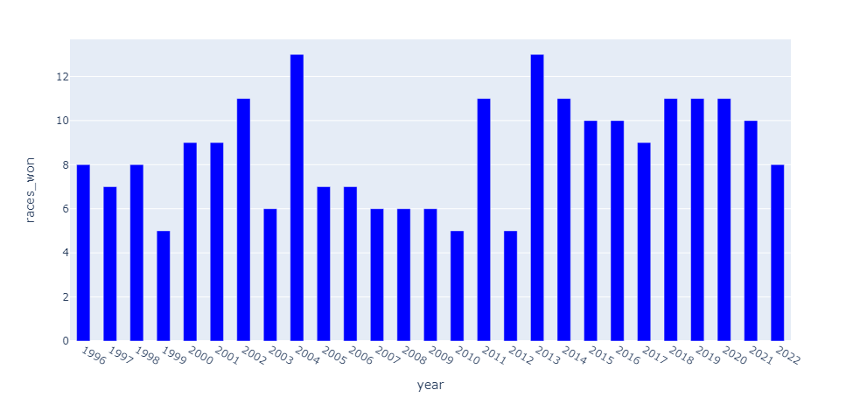
Maximum number of races won by a single driver across seasons
There doesn’t seem to be a significant pattern for the races won by a single driver across seasons however the numbers have been on the lower side from 2005 to 2012 (exception for 2011) as compared to the other years from which we can say that there was tough competition between the drivers specifically during these years.

Slide 15
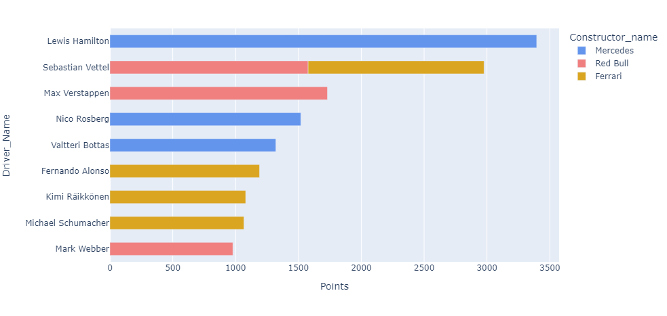
Top 10 Constructor – Driver combo (based on points)
Lewis Hamilton has been on top of the charts along with Mercedes in terms of the total number of points followed by Max Verstappen from Red bull when looking at a constructor-driver combo. However, Sebastian Vettel takes over Verstappen when considering the total driver points (irrespective of the constructor they were with)

Slide 16
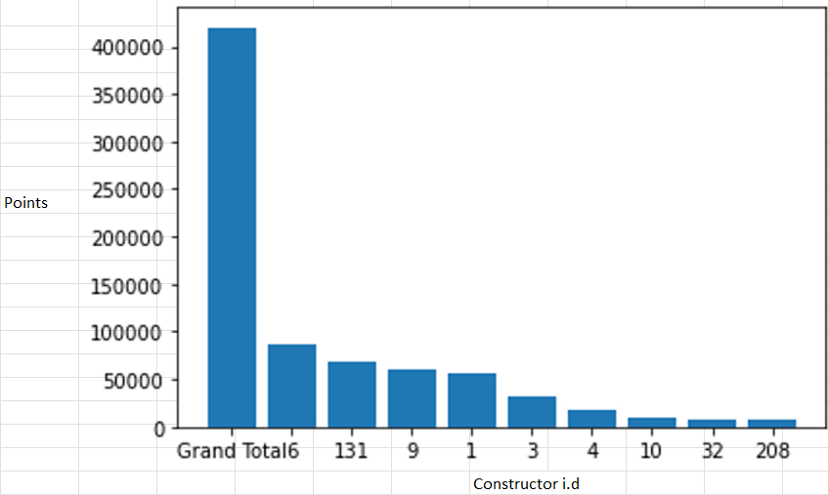
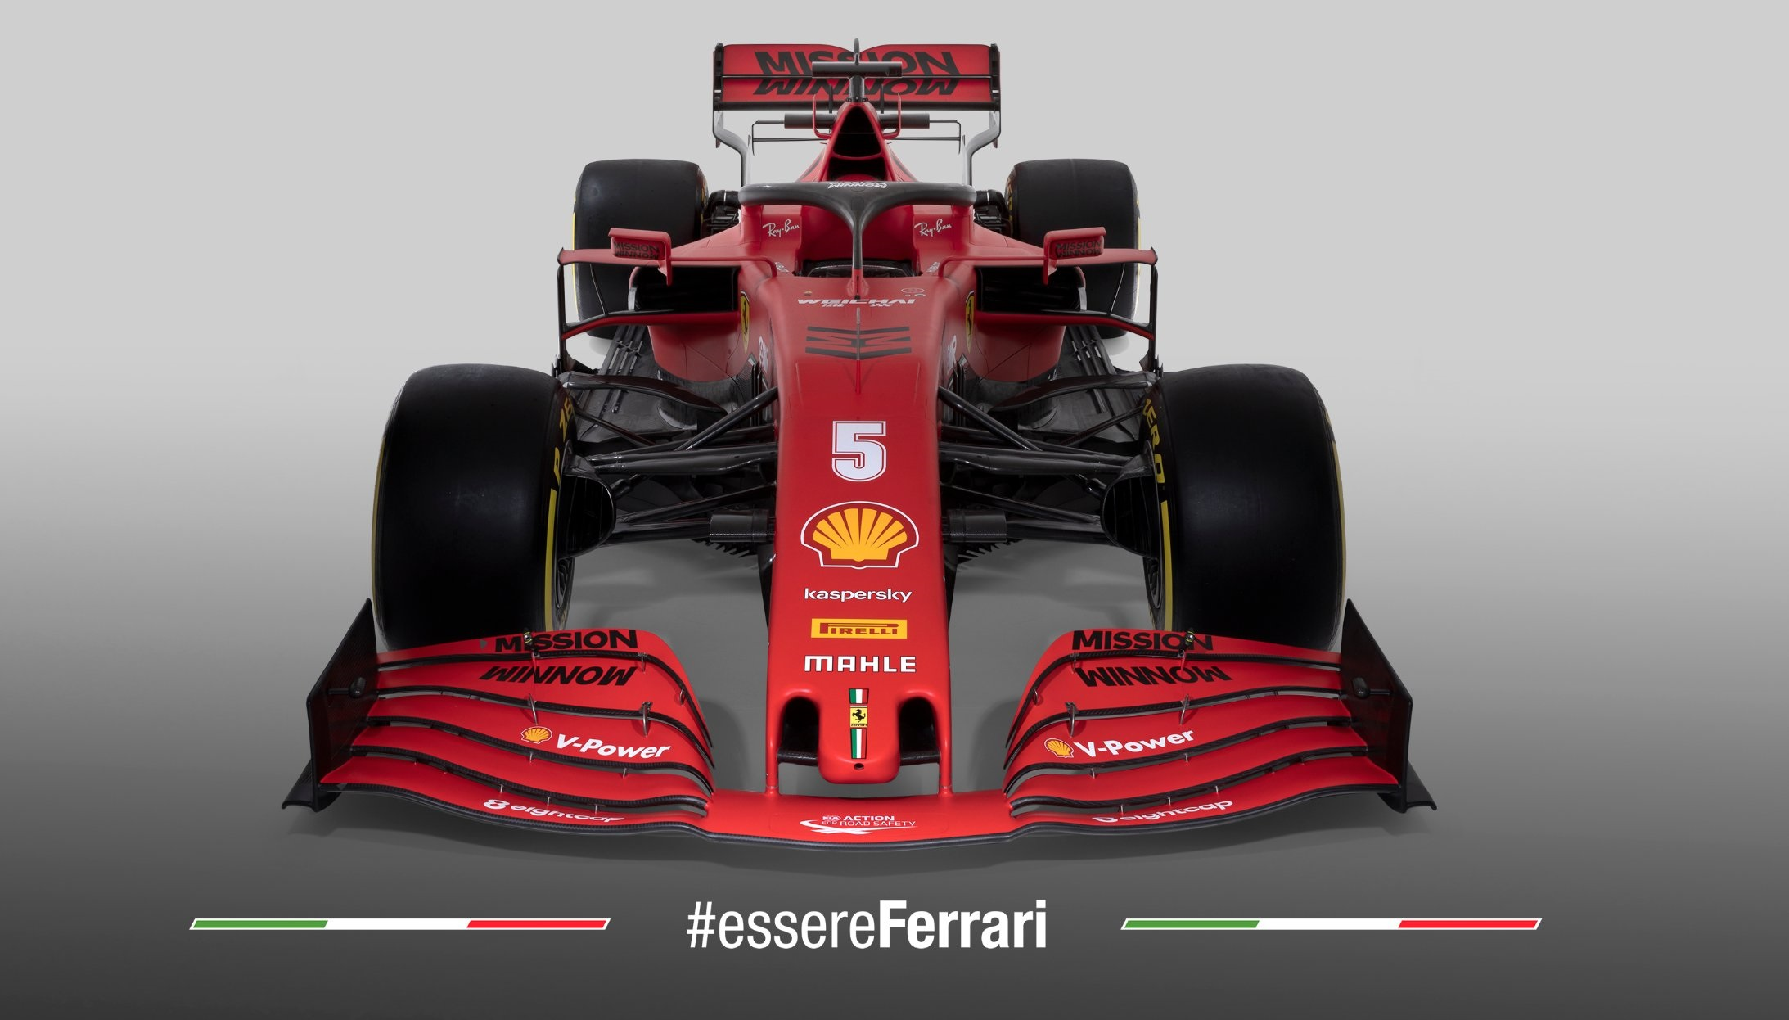
Best Constructor(based on points)
This bar chart represents the relationship between the constructor I.d and the points each constructor contributes, and the leading constructor is Ferrari with 86138 points.
So, Ferrari is the best constructor.

Slide 17
Key Takeaways
Italy hosted the max number of F1 races with over a 100 races overall
2005 to 2012 observed a high competition among the drivers resulting in lower number of max races won by a single driver
Lewis Hamilton has been dominating the F1 races along with Mercedes as his constructor
Fast pitstops do play a part in winning the race
Lewis Hamilton has won minimum races until 2021. His total is 103.
Lewis Hamilton has the highest number of fastest lap times followed by Vettel and Verstappen
The lap times have seen a slight decrease in time over the years
The reason being the changes made in the car, may it be the car design, engine, tires and the skills of the driver as well.
The pitstop times are not constant it has, increases and decreases, but the pattern here is the increase in pitstop time is doubled after every reduced pitstop time.

Slide 18
Thank You
Notes:
What is pit stop and why it is imp? They replace tires, refuel, repair damaged wings or make other modifications to the car to change the down-force and improve performance.
In order to do this analysis, I have choosen random races to find out whether pitstops affects in winning a race.
From ’raceId 841’ on ‘Position 1’ has taken 2 pit stops for (1st at 21.6 and 2nd at 24.03 ) total = 45.9 less than a minute
and ‘Position 7’ has taken 3 pit stops for (1st at 23.8 and 2nd at 24.09 and 3rd at 24.5 ) total = 72.39 which is 1min 12sec
In both the position 1 and 7 has difference of 43sec.
From ’raceId 1086’ on ‘Position 1’ has taken 2 pit stops for (1st at 21.2 and 2nd at 21.3 ) total = 42.5
and ‘Position 7’ has taken 2 pit stops for (1st at 21.8 and 2nd at 23.5 ) total = 45.3
In both the position 1 and 7 has difference of 4sec. Both of them have taken 2 pit stops.
From both the graph we conclude that Yes, fast pitstops do contribute in wining the race.

